Slide 1
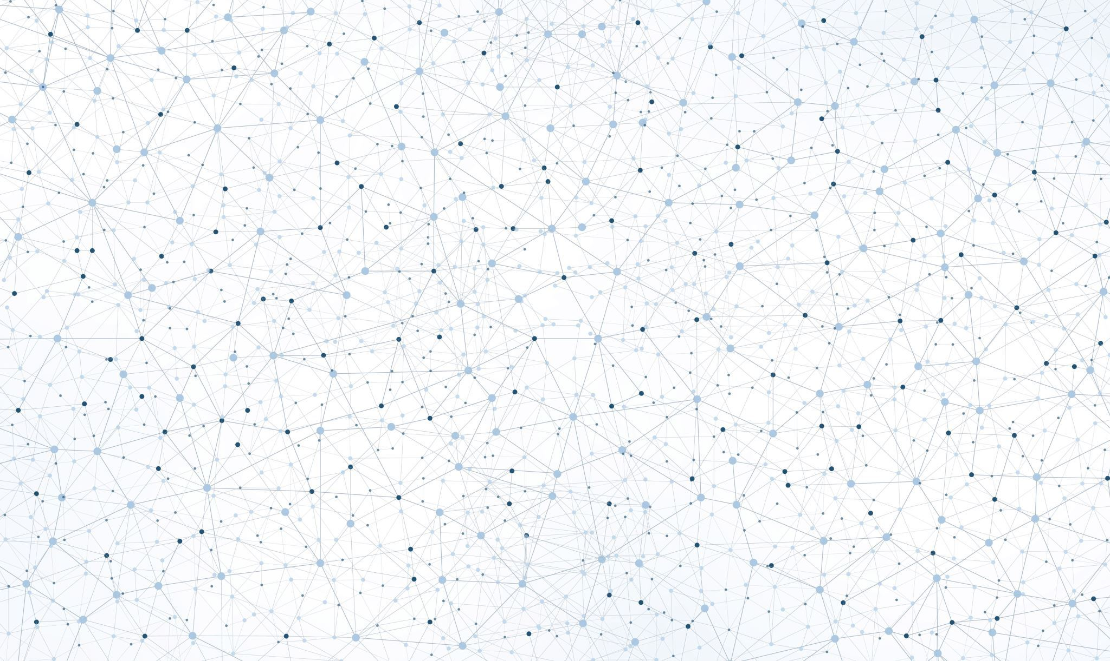
MACHINE VISION DIGITAL ASSIGNMENT - 2
PROJECT ON COLORS DETECTION USING ML
AKARSHIT MISRA (21BAI1597)

Slide 2
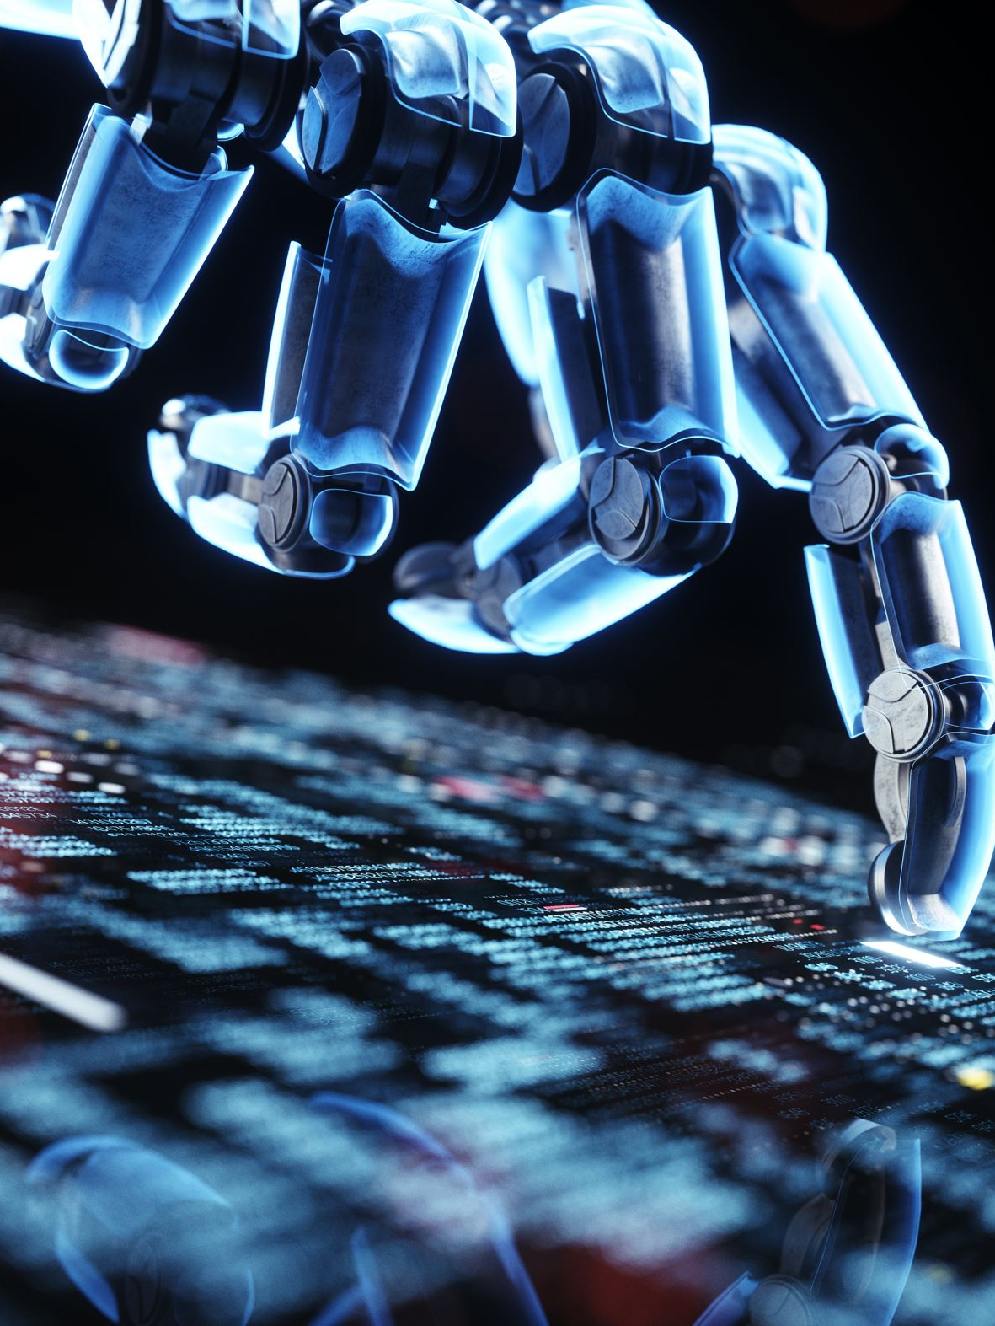
INTRODUCTION
Machine vision has emerged as a powerful technology that enables machines to perceive and interpret visual information, mimicking the human visual system. One fascinating application of machine vision is color detection, which involves the accurate identification and analysis of colors within images or videos. Color detection plays a crucial role in various industries, including robotics, quality control, automation, and image processing.
The ability to recognize and differentiate colors is fundamental for many tasks performed by machines. For instance, in industrial automation, color detection is used to identify and sort objects based on their color, ensuring efficient and accurate assembly line operations. In robotics, color detection enables robots to interact with their environment and perform tasks such as object recognition, navigation, and grasping.

Slide 3

INTRODUCTION
The goal of a color detection project is to develop robust algorithms and techniques that can accurately detect and classify colors in real-time. This involves capturing images or video frames, extracting color information, and applying sophisticated image processing and machine learning algorithms to identify and categorize different colors.
Color detection algorithms typically involve several steps, including color space conversion, thresholding, segmentation, and classification. Color space conversion transforms the color representation from the RGB (Red, Green, Blue) color model to other color spaces such as HSV (Hue, Saturation, Value) or LAB (Lightness, A, B). Thresholding is used to separate colors of interest from the background or other unwanted colors. Segmentation techniques are then employed to isolate regions or objects based on their color properties. Finally, machine learning algorithms can be applied to classify the detected colors into predefined categories or to train the system to recognize new colors.

Slide 4

OBJECTIVES
In this project, we will explore and develop a color detection system using state-of-the-art techniques and algorithms. We will investigate different color spaces, analyze various thresholding and segmentation approaches, and evaluate the performance of different machine learning models. The aim is to build an accurate and robust color detection system that can be applied in real-world scenarios to enhance automation, robotics, and image processing applications.
By advancing the field of color detection, we can unlock a wide range of opportunities for machines to perceive and interact with the world around them. This project will contribute to the growing body of knowledge in machine vision and pave the way for innovative applications that rely on accurate color detection.

Slide 5

RELATED WORK
The goal of a color detection project is to develop robust algorithms and techniques that can accurately detect and classify colors in real-time. This involves capturing images or video frames, extracting color information, and applying sophisticated image processing and machine learning algorithms to identify and categorize different colors.
Color detection algorithms typically involve several steps, including color space conversion, thresholding, segmentation, and classification. Color space conversion transforms the color representation from the RGB (Red, Green, Blue) color model to other color spaces such as HSV (Hue, Saturation, Value) or LAB (Lightness, A, B). Finally, machine learning algorithms can be applied to classify the detected colors into predefined categories or to train the system to recognize new colors.

Slide 6

LIMITATIONS
Color detection is a complex task in machine vision, and despite significant progress, there are several limitations that researchers and developers need to consider. One of the primary limitations is the dependence of color detection algorithms on lighting conditions. Shadows and reflections further complicate the detection process, as they can alter the appearance and perceived colors of objects. Adapting color detection algorithms to handle diverse lighting environments and ensuring consistent color perception across different conditions remains an ongoing challenge.
Another limitation is the inherent variability and complexity of color appearances. Colors can exhibit variations due to factors such as surface texture, glossiness, and viewing angle. These variations can lead to different color perceptions even for the same object or surface. Developing algorithms that can account for these variations and provide accurate color detection results under diverse conditions is a complex task that requires robust modeling and calibration.

Slide 7

LIMITATIONS
Noise and image quality also pose limitations in color detection projects. In real-world scenarios, images or videos captured for color analysis may suffer from noise, artifacts, or low resolution. Such issues can introduce spurious color information, disrupt color boundaries, and affect the accuracy of the detection process. Handling noisy inputs and developing noise-robust algorithms are crucial for reliable color detection.
Furthermore, the choice of color space and representation can impact the performance of color detection algorithms. Different color spaces, such as RGB, HSV, LAB, or CMYK, have varying capabilities in representing color information.
Lastly, the computational complexity and processing requirements of color detection algorithms can be a limitation, especially for real-time or resource-constrained applications. Some advanced algorithms, such as deep learning models, may require substantial computational resources and training data. Implementing and deploying such algorithms in embedded systems or real-time applications may pose challenges in terms of speed, memory, and power constraints.

Slide 8
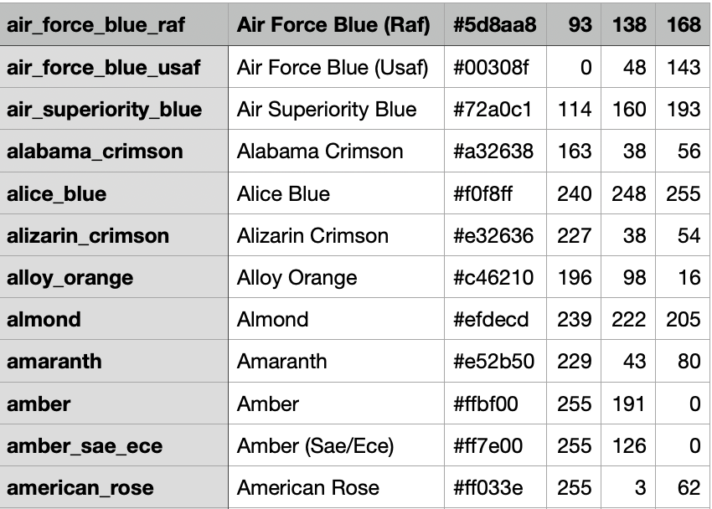
DATASET

Slide 9

PROPOSED METHODOLOGY
To enhance the accuracy and performance of machine vision projects focused on color detection, several modifications and methodologies can be considered. The proposed approach involves incorporating advanced techniques and algorithms to overcome the limitations and challenges faced in color detection.
Firstly, an adaptive lighting compensation technique can be integrated into the color detection pipeline. This technique aims to address the impact of varying lighting conditions by capturing additional information about the lighting environment and applying appropriate adjustments to normalize the color values. Statistical methods, such as histogram equalization or color constancy algorithms, can be utilized to achieve more consistent color perception across different lighting conditions.
Secondly, a multi-color model fusion strategy can be employed to improve color detection accuracy. Instead of relying solely on a single color space, a fusion of multiple color models can be explored. This fusion can involve combining the strengths of different color spaces, such as RGB, HSV, and LAB, to create a more comprehensive representation of color information. By leveraging the unique characteristics of each color model, the color detection system can achieve enhanced accuracy and robustness

Slide 10

PROPOSED METHODOLOGY
To handle noisy images or videos, incorporating noise reduction techniques is crucial. Denoising algorithms, such as Gaussian filtering, median filtering, or wavelet-based methods, can be applied to remove noise while preserving the color information. Adaptive filtering techniques can also be utilized to selectively filter noise based on local image characteristics, ensuring a balance between noise reduction and color accuracy.
Additionally, dataset augmentation techniques can be employed to improve the generalization capability of color detection models. By artificially generating variations in color images through techniques such as rotation, scaling, flipping, and adding noise, the models can learn robust color features and perform better in real-world scenarios.
Efficient real-time optimization is essential for many color detection applications. Techniques such as model compression, network pruning, and quantization can be employed to reduce the computational complexity of the models without significant loss in accuracy. Hardware acceleration techniques, such as utilizing specialized hardware like GPUs or FPGAs, can also be explored to expedite the color detection process.

Slide 11

PROPOSED METHODOLOGY
Lastly, incorporating user feedback and calibration mechanisms can enhance the adaptability and accuracy of the color detection system. Allowing users to provide input or corrections on detected colors can help refine the system's performance over time. Calibration techniques, such as color calibration cards or reference objects, can be utilized to ensure accurate color representation and consistent detection across different devices or environments.
By implementing these modifications and methodologies, the proposed approach aims to significantly enhance the accuracy, robustness, and efficiency of color detection in my machine vision project. These advancements can enable more reliable color-based decision-making, object recognition, and automation in various domains, ranging from robotics and manufacturing to quality control and image processing.

Slide 12
PROPOSED METHADOLOGY
You will need the Sklearn libraries for the Machine Learning part, Numpy for the vector transformations, Pandas for the final summary and some Image Processing typical libraries (cv2, skimage, matplotlib.pyplot, …)
he main idea is pretty basic. In fact, the image is RGB encoded. That means that if we compute the difference between the image and the rgb expression of one of the 10 colors, we get [0,0,0] exactly when the image is equal to the color.
Then, if we want to identify the colors of the image, the idea is to break this image into smaller squares. In this case, I’ve chosen the dimension of each square to be N rows/10 X N columns/10, thus obtaining 100 squares. These squares are obtained by using a function.
Of course, the squares are not monochromatic. This means that each square will have multiple colors. Nonetheless, the average distance between the image is the indicator that we need: we pick the color that, in average, is closer to 0 than the others. In particular, we do that by using a function:
With this function, we can plot the “best color” for each square.

Slide 13
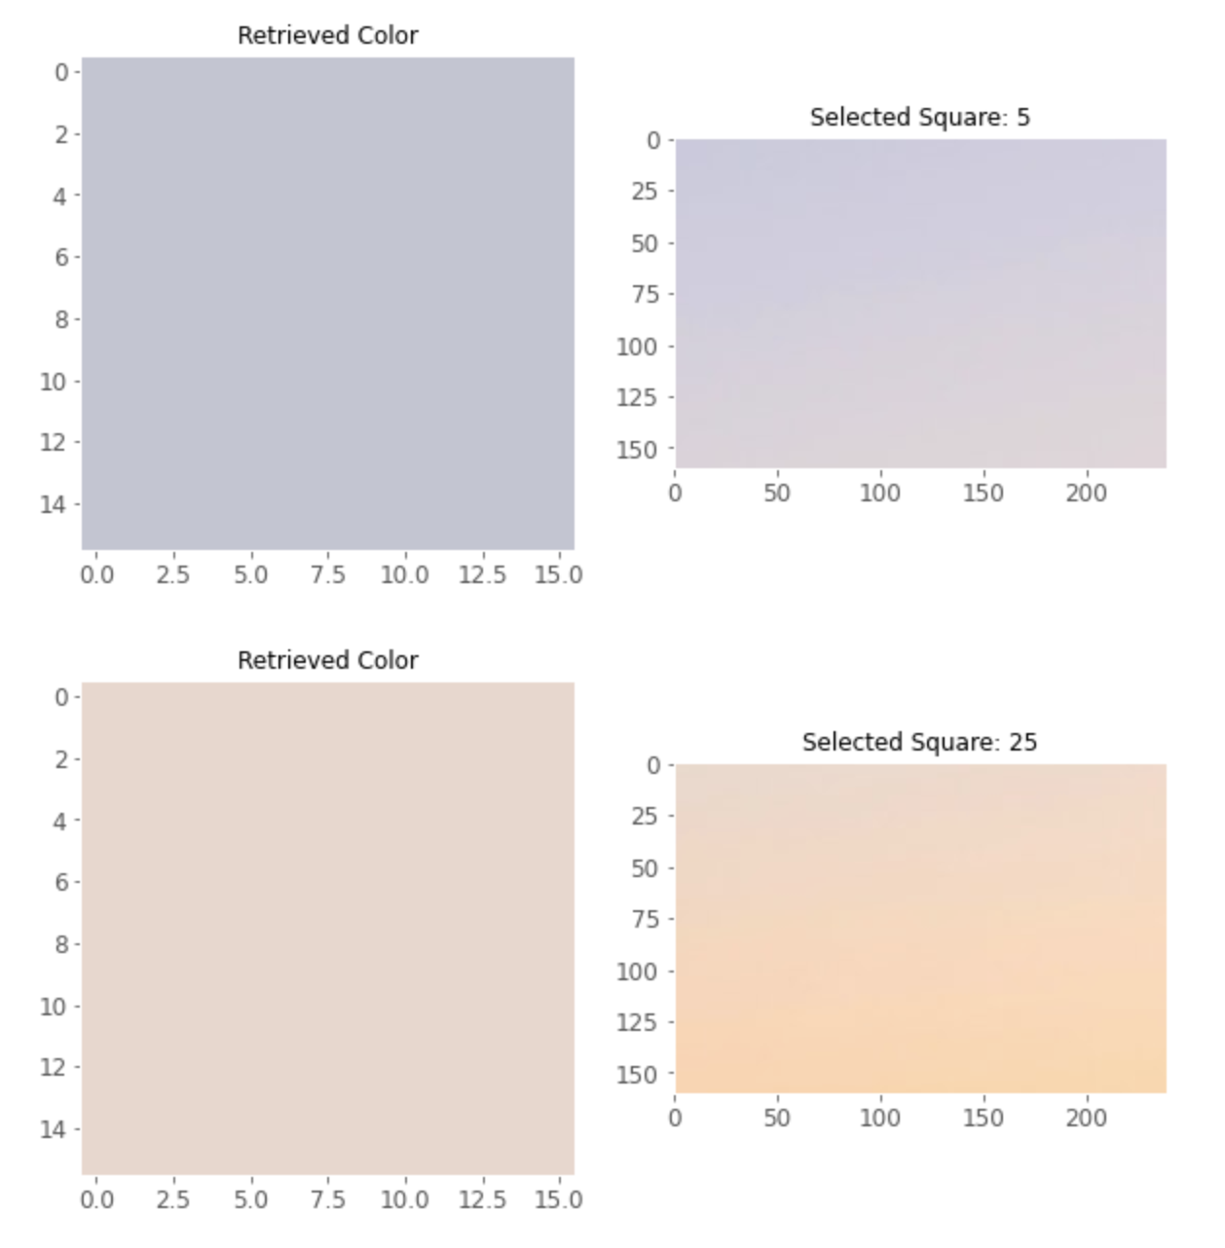
PRELIMINARY RESULTS

Slide 14
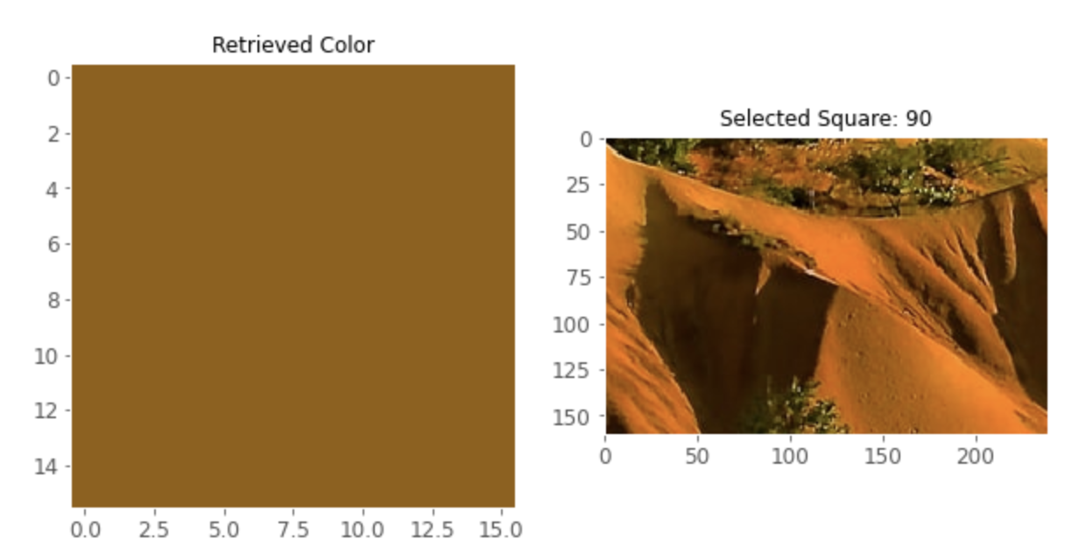
PRELIMINARY RESULTS

Slide 15
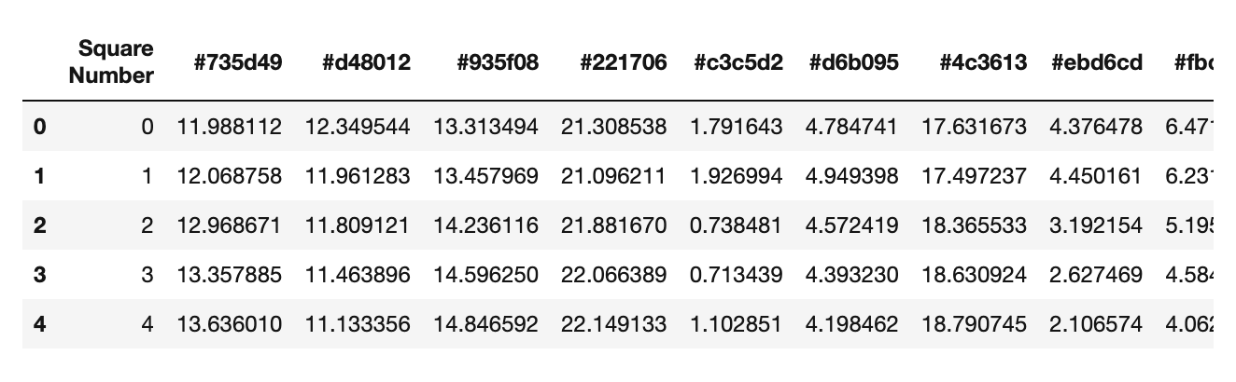
SUMMARY OF RESULTS

Slide 16

THANK YOU THE END

